Slide 1
The Opioid Crisis in Virginia
David E. Brown, DC
Director, Department of Health Professions

Slide 2
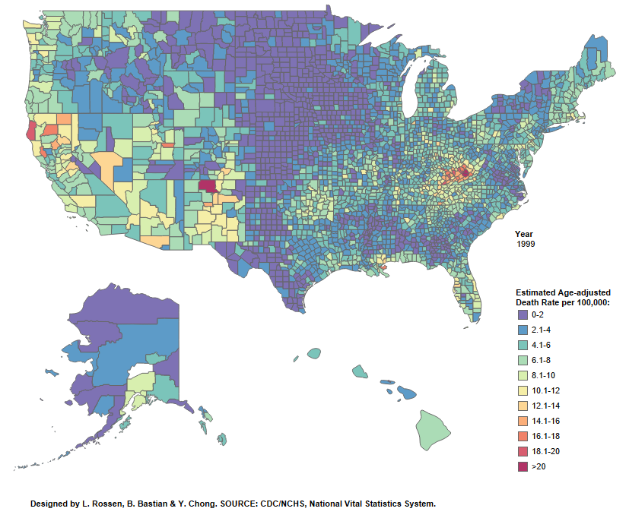
1999 - Estimated drug overdose deaths

Slide 3
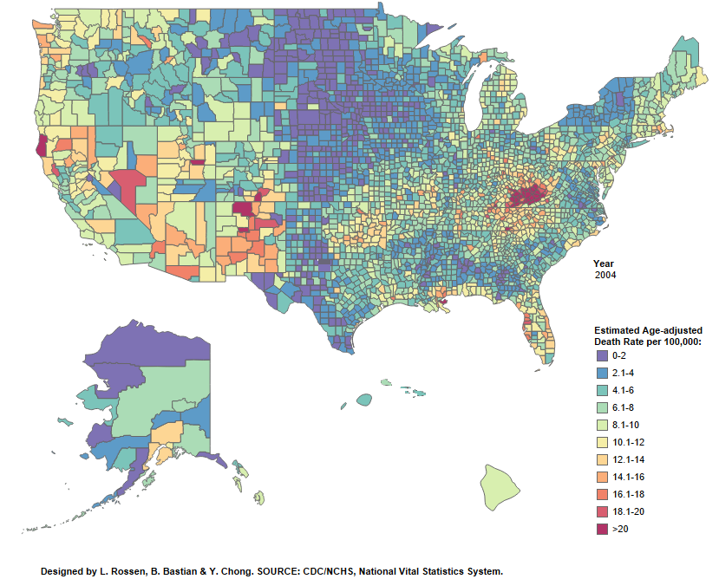
2004 - Estimated drug overdose deaths

Slide 4
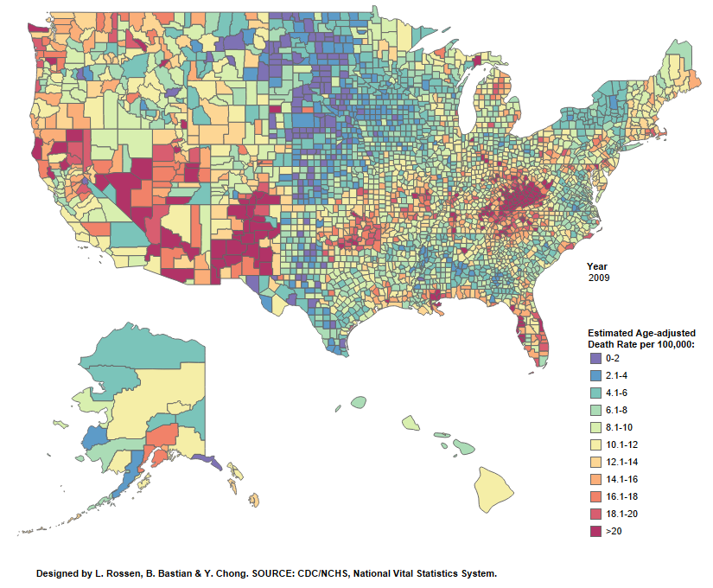
2009 - Estimated drug overdose deaths

Slide 5
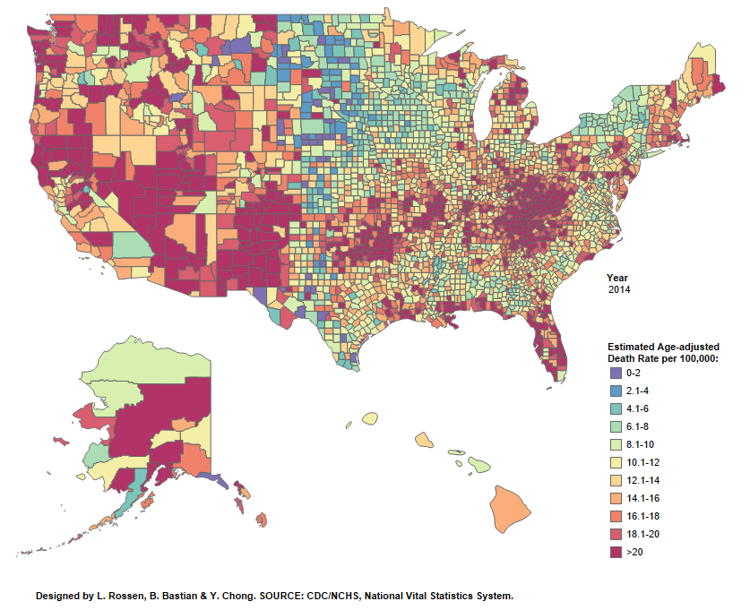
2014 - Estimated drug overdose deaths

Slide 6
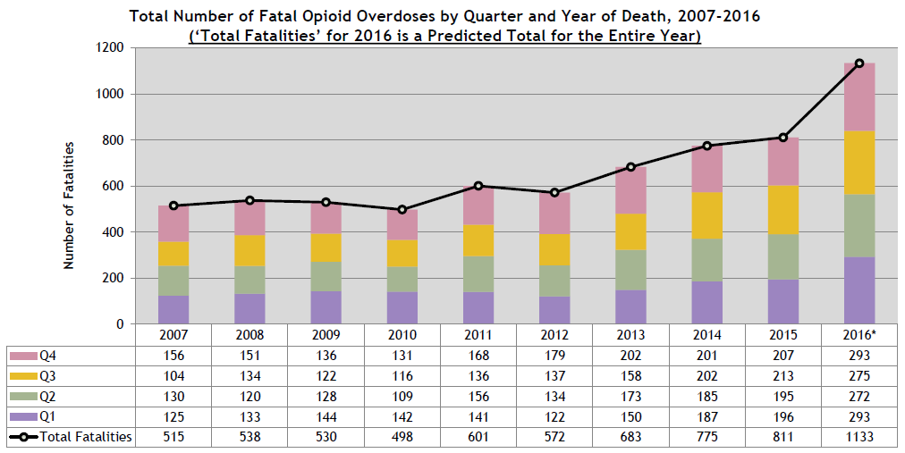
811 deaths in 2015, 1133 deaths in 2016: a 40% increase
Source: Virginia Department of Health, Office of the Chief Medical Examiner, 2017

Slide 7
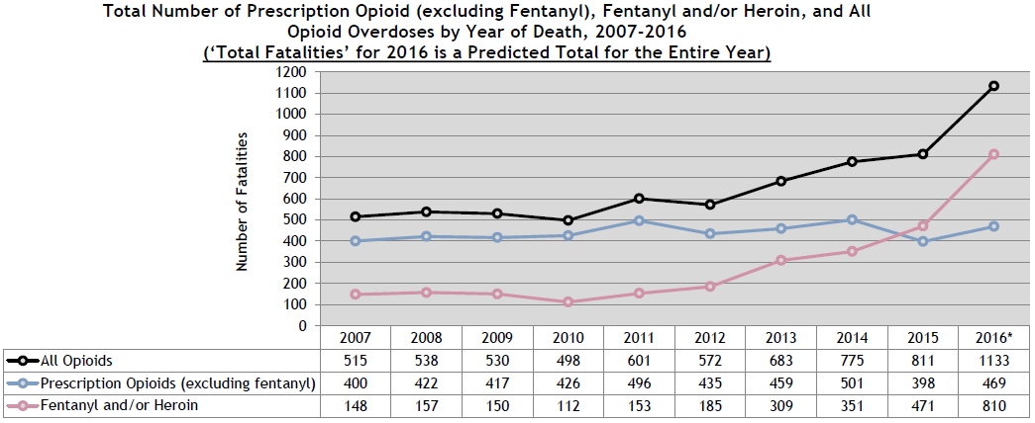
Source: Virginia Department of Health, Office of the Chief Medical Examiner, 2017

Slide 8
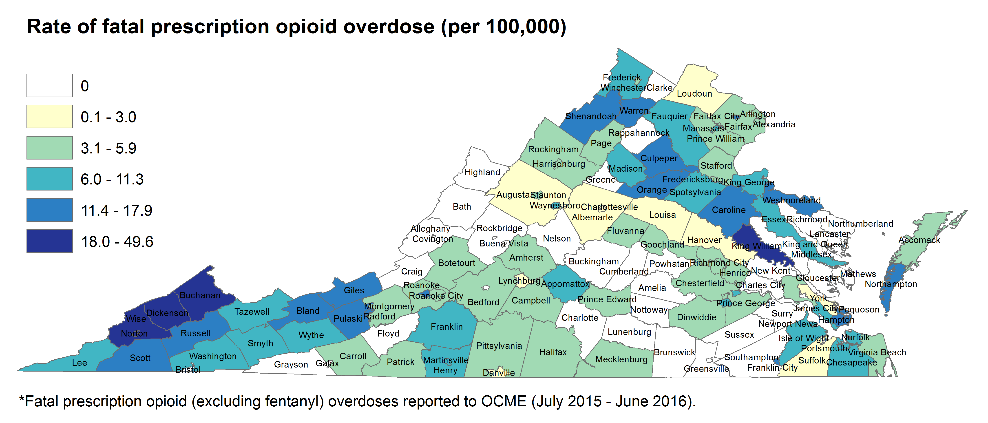
Source: Virginia Department of Health, Office of the Chief Medical Examiner, 2016

Slide 9
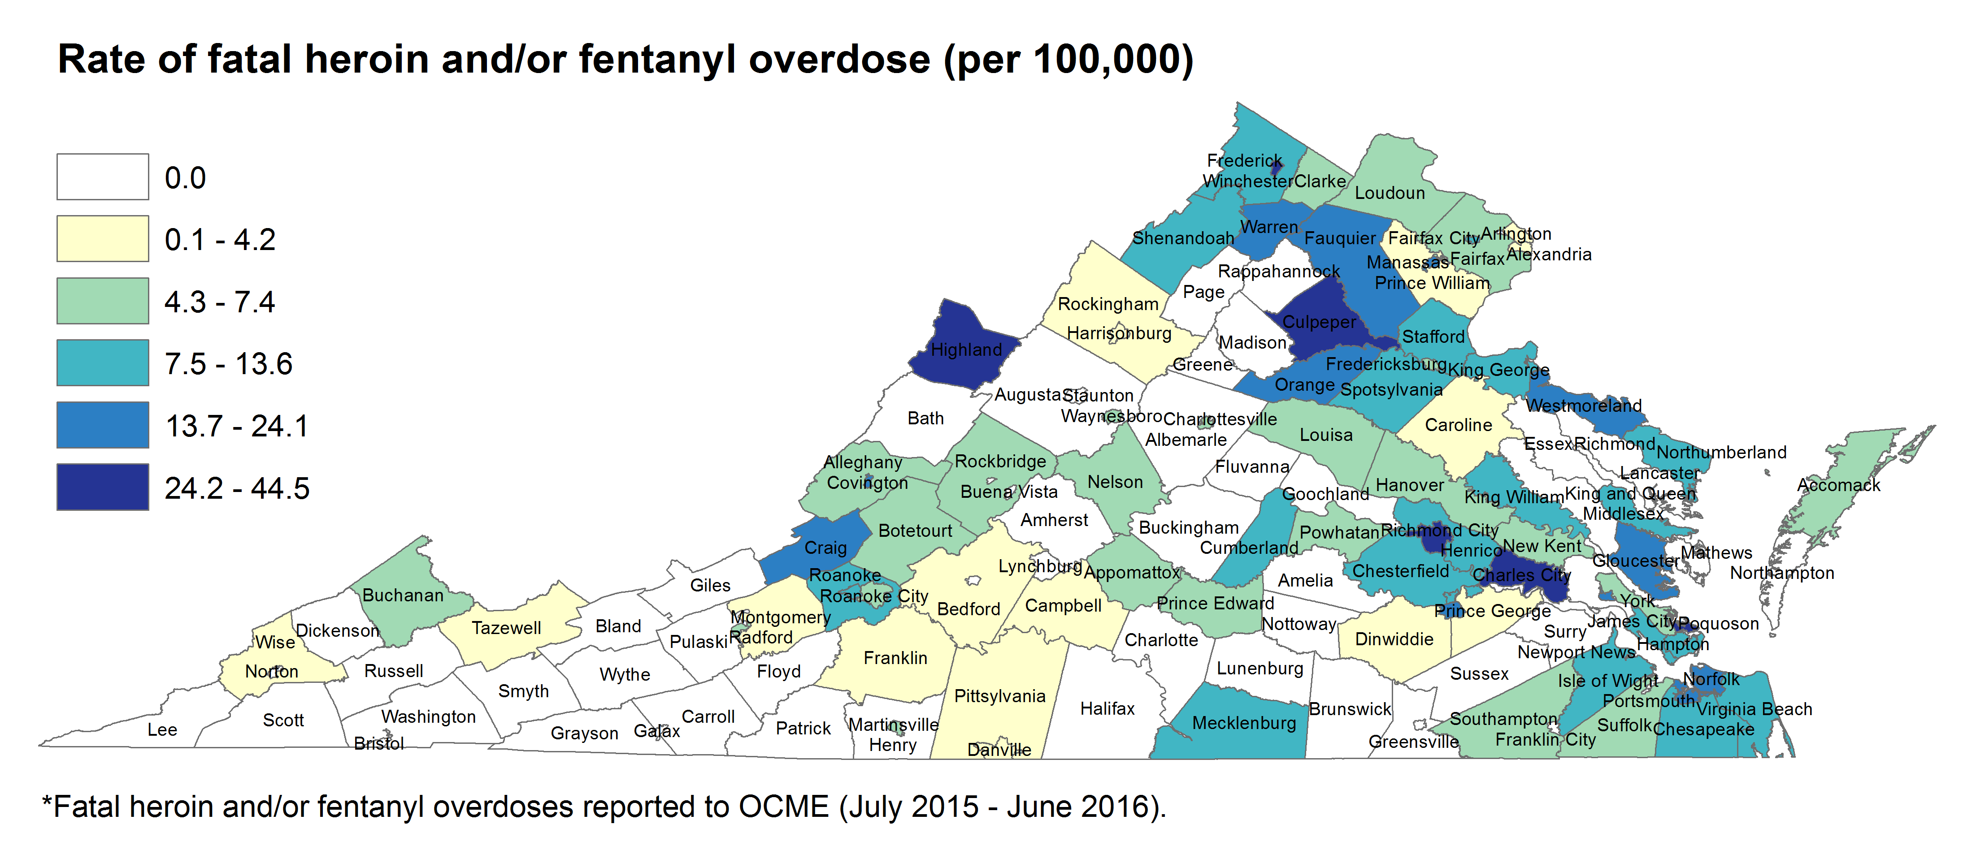
Source: Virginia Department of Health, Office of the Chief Medical Examiner, 2016

Slide 10
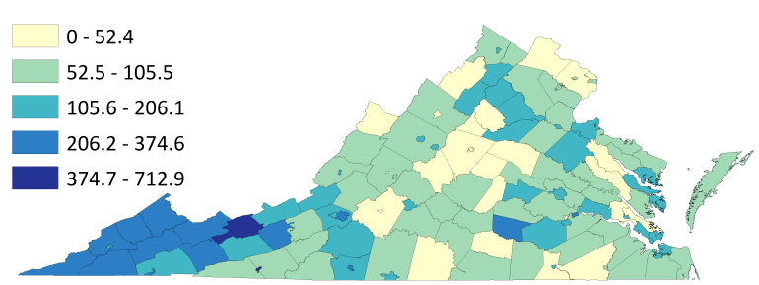
Reported hepatitis C per 100,000
Source: Virginia Department of Health, 2016

Slide 11
Source: Virginia Department of Health

Slide 12
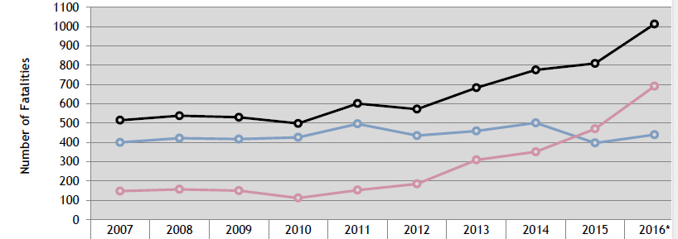

Increasing Deaths Due to Heroin and Fentanyl
Source: Virginia Department of Health

Slide 13
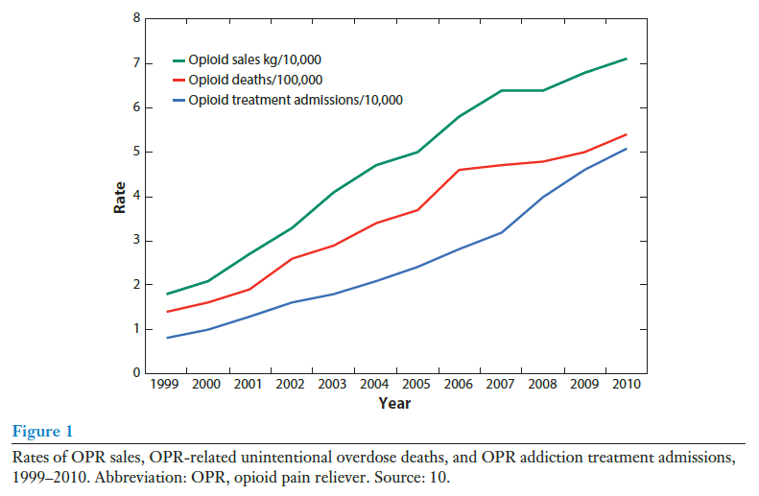
Annual Review of Public Health 2015 Vol. 36: 559-574

Slide 14
Prescription Opioids and Heroin
Prescription opioid use a risk factor for heroin use
Numerous stories of addiction following prescribing for acute pain
Dependence on or abuse of prescription opioids associated with a 40-fold increased risk of heroin abuse
75% - 85% of heroin users first opioid was prescription
Obtained from family, friends or personal prescription
In the 1960s, 80% first opioid was heroin
11% of high school seniors report non-medical use of prescription opioids
Source: National Institute on Drug Abuse

Slide 15
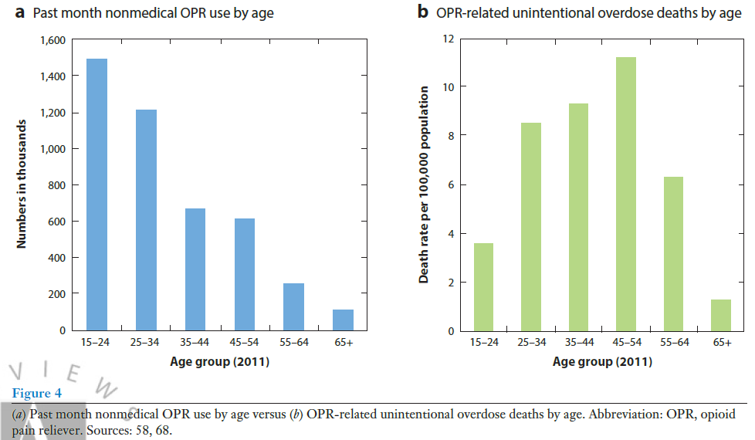
Annual Review of Public Health 2015 Vol. 36: 559-574

Slide 16
Department of Health Professions
Licenses and regulates all prescribers, pharmacists and pharmacies
Board of Nursing
Board of Medicine
Board of Pharmacy
Board of Dentistry
Board of Veterinary Medicine
Board of Optometry
Prescription Monitoring Program

Slide 17
Prescription Monitoring Program
24/7 Database of Schedule II – IV Prescriptions
Resource for Prescribers and Pharmacists
Pharmacies, other dispensers report within 24 hours
PMP is interoperable with 24 states, including MD, WV, KY & TN
Reporting of outlier prescribing, dispensing for investigation
Reporting of doctor shopping behavior to law enforcement
Automatic registration of prescribers, pharmacists
Still requires account activation (password creation)

Slide 18
Prescription Monitoring Program
Mandatory use prescription > 7 days supply
Expanded delegate access
Licensed or unlicensed office staff
Staff create separate account
Integration of the PMP into EMRs and Pharmacy Software
$3.1 grant from Purdue
No separate login
Overdose risk scores

Slide 19
2017 Virginia Initiatives
Needle exchange
e-Prescribing of opioids in 2020 (workgroup)
Opioid curricula (workgroup)
Medicine, Dentistry, Nursing, PA, Pharmacy
Peer recovery specialists
Naloxone distribution
Revive trainings
Commissioner of Health Standing Order
CE to include 2 hours opioids
PMP check if prescription > 7 days ( > 14 days post-surgical )
Partial filling of Schedule II prescriptions
Boards of Medicine, Dentistry, Nursing, Veterinary Medicine opioid regulations

Slide 20
Treatment
Lack of Medicaid expansion a problem
One-year SAMSHA $10 Million grant (select CSBs)
Increase the number of MAT-waivered providers
Office-based Outpatient Treatment
Includes NP & PA
Medicaid ARTS program
Increased reimbursement

Slide 21
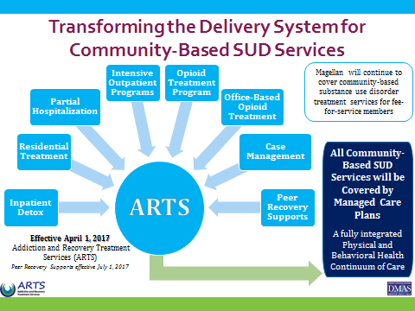
Source: Virginia Department of Medical Assistance Services

Slide 22
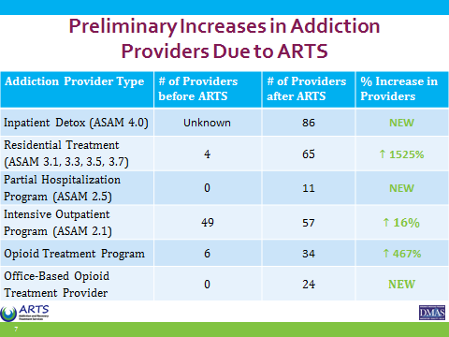
Source: Virginia Department of Medical Assistance Services

Slide 23
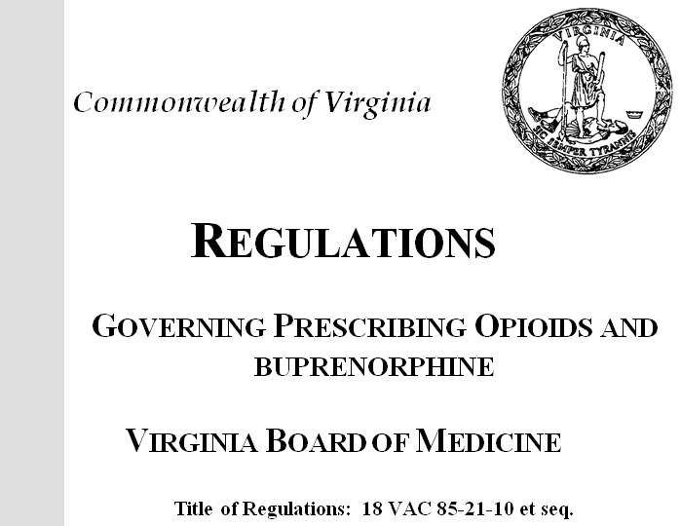

Slide 24
Mandated by 2017 legislation
Emergency regulations, effective March 15, 2017
Permanent regulations within 18 months
Opportunity for comment and amendment
Created using a Regulatory Advisory Panel
Based on guidelines, best practices
Acute Pain
Chronic Pain
Buprenorphine

Slide 25
Regulations: Acute Pain Key Concepts
Consider non-pharmacologic and non-opioid treatments prior to using opioids
If necessary, a short-acting opioid shall be written in the lowest dose for the fewest possible days, not to exceed 7 days unless extenuating circumstances are fully documented (14 days for post-op pain)
An appropriate history and physical, an assessment of the patient’s history and risk of substance misuse

Slide 26
Regulations: Acute Pain Key Concepts
Co-prescribing of benzos, sedative hypnotics, and carisoprodol only if extenuating circumstances, with a tapering plan to achieve lowest possible effective dose
Consider the MME
Document why the initial dose should exceed 50 MME/day
Prior to exceeding 120 MME/day, document why or consult with or refer to a pain specialist
Prescribe naloxone if >120MME/day, hx prior overdose or abuse, or concomitant benzodiazepine

Slide 27
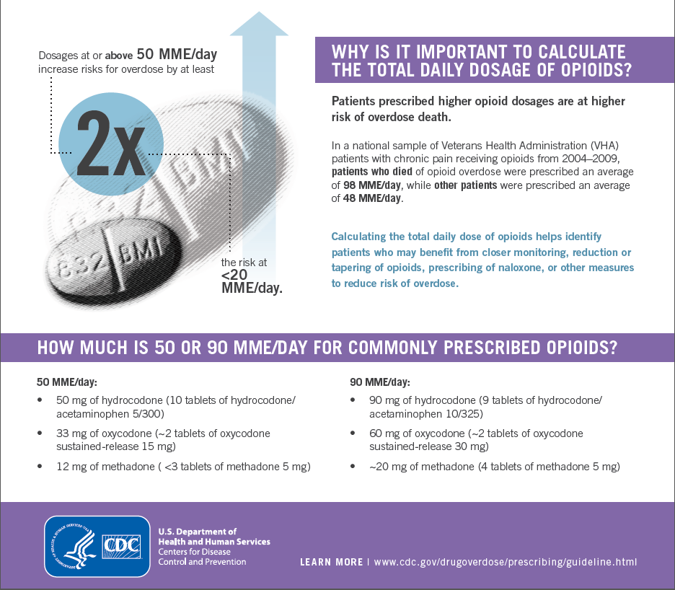

Slide 28
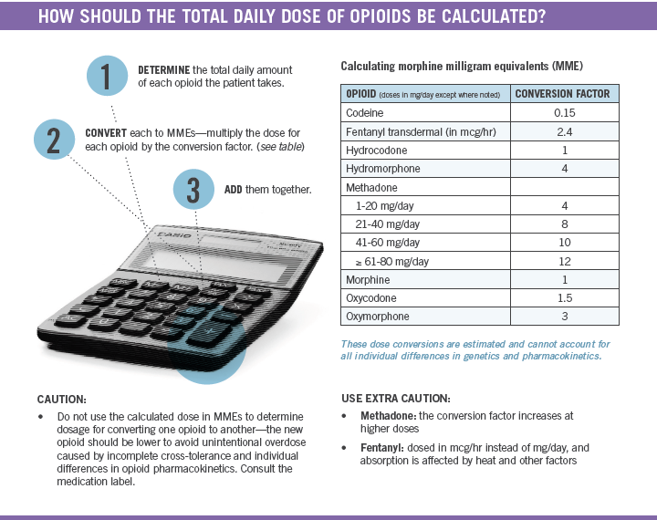


Slide 29
Regulations: Chronic Pain Key Concepts
Initial evaluation to include history, physical and mental status
Urine drug screen or serum medication level
PMP check
Assessment of risk of substance misuse
Risk/benefit discussion, informed consent and treatment agreement

Slide 30
Regulations: Chronic Pain Key Concepts
Consider the MME
Document why the dose should exceed 50 MME/day
Prior to exceeding 120 MME/day, document why or consult with or refer to a pain specialist
Naloxone if >120MME/day, hx prior overdose or abuse, or concomitant benzodiazepine
Co-prescribing of benzos, sedative hypnotics, and carisoprodol only if extenuating circumstances, with a tapering plan to achieve lowest possible effective dose

Slide 31
Regulations: Chronic Pain Key Concepts
Every 3 months:
Review course of treatment, overall state of health
Document rationale for continuing opioids
Check PMP
Urine screen every 3 months first year, every 6 months thereafter
Regularly evaluate for misuse
Initiate treatment, consult or refer

Slide 32
Regulations: Buprenorphine Prescribing for Addiction Key Concepts
SAMHSA waiver required
NPs, PAs with practice agreement with waivered physician
Provide or refer for counseling
Buprenorphine monoproduct (subutex) only for:
Pregnancy
Conversion from methadone or buprenorphine
Non-tablet form as FDA approved
3% allowance for documented intolerance to naloxone (suboxone)

Slide 33


Slide 34

www.vaaware.com

Slide 35
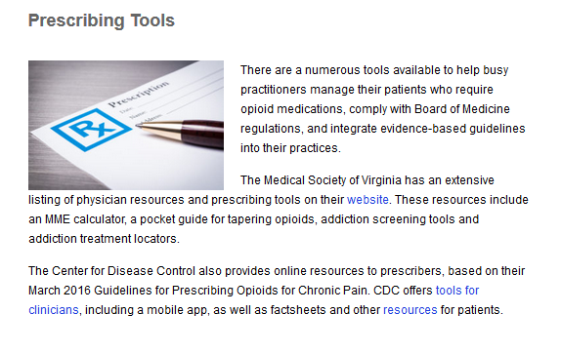

Slide 36
Contact Information
Department of Health Professions
www.dhp.virginia.gov
david.brown@dhp.virginia.gov
Board of Medicine
www.dhp.virginia.gov/medicine
medbd@dhp.virginia.gov
www.vaaware.com

