Slide 1
Health & Criminal Justice Data Committee Report to the Governor’s Task Force on Prescription Drug and Heroin Abuse Includes preliminary 2015 data May 4, 2016
Presenting data from the Department of Forensic Science, and the Office of the Chief Medical Examiner and Office of Family Health Services at the Virginia Department of Health

Slide 2
Fatal Overdose in Virginia: Prescription Opioids and Heroin 2015 data are incomplete. Presented here are predicted totals, subject to change.
2013-14 | 12% | 9%
2014-15* | 44% | 2%
Data Source: OCME Fata Drug Overdose Quarterly Report http://www.vdh.virginia.gov/medExam/ForensicEpidemiology.htm
*2015 data are incomplete.
Notes:
The graphs on the map above compare the proportion of the state’s population that lived in that Division in 2014 (black bar) to the proportion of drug cases submitted to DFS in CY 2014, for the listed drug types. For example, about 5% of Virginia’s population in 2014 lived in Division 4, but that Division submitted about 26% of benzodiazepine cases.

Slide 3
Virginia Prescription Opioid Data Hospitalizations & Fatal Overdoses (Left Axis) and Cases Submitted to DFS (Right Axis)
Data Sources: OFHS response to data request; OCME Fatal Drug Overdose Quarterly Report (2015 data are projected, preliminary figures); DFS monthly submission to NFLIS
Notes:
Statewide, methamphetamine cases submitted to DFS increased 264% between CY 2001 and 2005. Following a high number of methamphetamine lab seizures, the number of methamphetamine cases dropped for several years, dropping 44% between 2005 and 2008. Between 2008 and 2014, cases increased 124%.The largest growth has been in Divisions 4 and 6.

Slide 4
Virginia Heroin Data Hospital Discharges & Fatal Overdoses (Left Axis) and Cases Submitted to DFS (Right Axis)
Data Sources: OFHS response to data request; OCME Fatal Drug Overdose Quarterly Report (2015 data are projected, preliminary figures); DFS monthly submission to NFLIS
Notes:
Statewide, methamphetamine cases submitted to DFS increased 264% between CY 2001 and 2005. Following a high number of methamphetamine lab seizures, the number of methamphetamine cases dropped for several years, dropping 44% between 2005 and 2008. Between 2008 and 2014, cases increased 124%.The largest growth has been in Divisions 4 and 6.

Slide 5
Fatal “Prescription Opioid” Overdoses 2015 data are incomplete. Presented here are predicted totals, subject to change.
2013-14 |  | 9%
2014-15* |  | 2%
Data Source: OCME Fata Drug Overdose Quarterly Report http://www.vdh.virginia.gov/medExam/ForensicEpidemiology.htm
*2015 data are incomplete.
Notes:
The graphs on the map above compare the proportion of the state’s population that lived in that Division in 2014 (black bar) to the proportion of drug cases submitted to DFS in CY 2014, for the listed drug types. For example, about 5% of Virginia’s population in 2014 lived in Division 4, but that Division submitted about 26% of benzodiazepine cases.

Slide 6
“Prescription Opioid” Fatalities 2015 data are incomplete. Presented here are predicted totals, subject to change. Not directly comparable with total combined fatalities. Some fatalities involve more than one prescription opioid.
2013-14 | 31% | 3% | 23% | 8% | -11%
2014-15* | 63% | -16% | -39% | -45% | -15%
Data Source: OCME Fata Drug Overdose Quarterly Report http://www.vdh.virginia.gov/medExam/ForensicEpidemiology.htm
*2015 data are incomplete.

Slide 7
Growth is in Fentanyl Overdose Fatalities Prescription Opioid Fatalities 2007-2015* 2015 data are incomplete. Presented here are predicted totals, subject to change.
2013-14 | 31% | 3%
2014-15* | 63% | -18%
Data Source: OCME Fata Drug Overdose Quarterly Report http://www.vdh.virginia.gov/medExam/ForensicEpidemiology.htm
*2015 data are incomplete.

Slide 8
How Should We Count Fentanyl?
Fentanyl is categorized as a prescription opioid because it is mass produced by pharmaceutical companies.
Recent surge is due to illicitly-produced fentanyl, not the prescription drug.
Illicit fentanyl appears to be produced in labs in Central and South America. Fentanyl derivatives (e.g., acetyl fentanyl) are produced in China.
Both the illicit fentanyl and derivatives are smuggled into the U.S. by Mexican drug cartels, sometimes mixed with heroin.
In prior analyses, fentanyl has been categorized with prescription drugs. Newer information indicates it would be more appropriate to look at it separately.

Slide 9
Overdose Fatalities Heroin vs Prescription Opioids vs Fentanyl & Derivatives 2015 data are incomplete. Presented here are predicted totals, subject to change.
Data Source: OCME Fata Drug Overdose Quarterly Report http://www.vdh.virginia.gov/medExam/ForensicEpidemiology.htm;
*2015 data are incomplete.
Notes:
Statewide, methamphetamine cases submitted to DFS increased 264% between CY 2001 and 2005. Following a high number of methamphetamine lab seizures, the number of methamphetamine cases dropped for several years, dropping 44% between 2005 and 2008. Between 2008 and 2014, cases increased 124%.The largest growth has been in Divisions 4 and 6.

Slide 10
Forms of Fentanyl – DFS Cases Prior to 2013, most Fentanyl samples were in the form of a transdermal patch
Data Source: DFS monthly submission to NFLIS

Slide 11
Forms of Fentanyl – DFS Cases Beginning in late 2013, other forms of Fentanyl became much more common
Data Source: DFS monthly submission to NFLIS.
*2015 data are incomplete.

Slide 12
Prescription Opioid DFS Cases 2015 Data Are Preliminary and Expected to Rise
Incl. Fentanyl(Patch)
2013-14 | 125% | -5% | -11% | 29% | -6%
2014-15* | 155% | -16% | -23% | 25% | -14%
Data Source: DFS monthly submission to NFLIS.
*2015 data are incomplete.

Slide 13
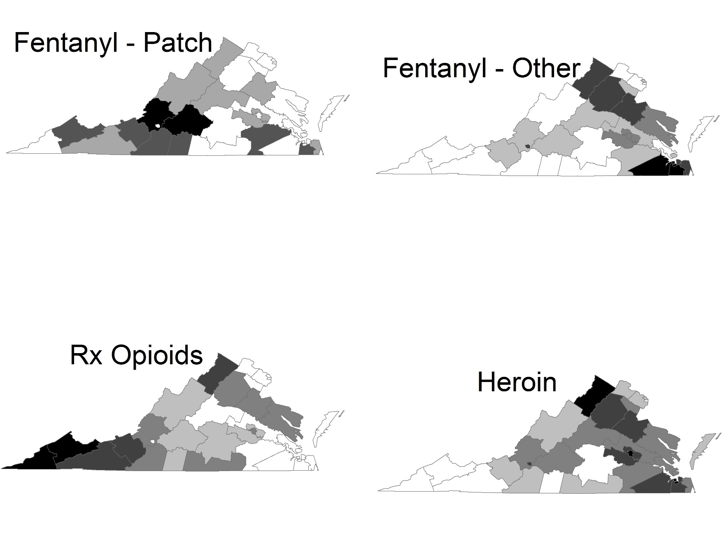
DFS Case Distribution Across Virginia Fentanyl(Patch) Compares with Rx Opioid; Fentanyl(Other) Compares with Heroin 2015 Cases submitted to DFS, Rate per 100,000, By Health District
Data Source: DFS monthly submission to NFLIS.
*2015 data are incomplete.

Slide 14
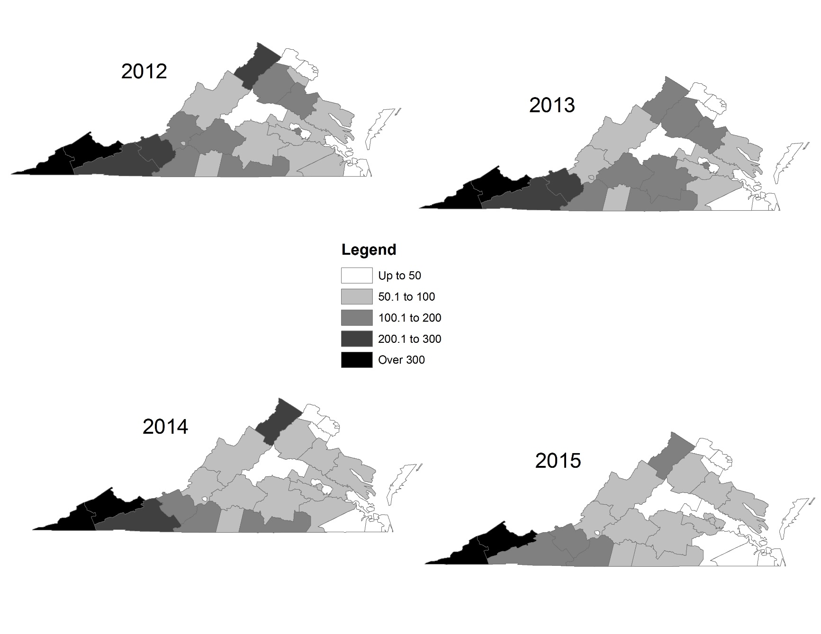
DFS Prescription Opioid Cases, By Health District Cases submitted to DFS, Rate per 100,000, By Health District 2015 Data Are Preliminary and Expected to Rise Includes Fentanyl (Patch), excludes other forms of Fentanyl
2012
2013
Statewide: 82.2
Statewide: 78.0
2014
2015*
Statewide: 75.4
Statewide: 67.2
Data Source: DFS monthly submission to NFLIS.
*2015 data are incomplete.

Slide 15
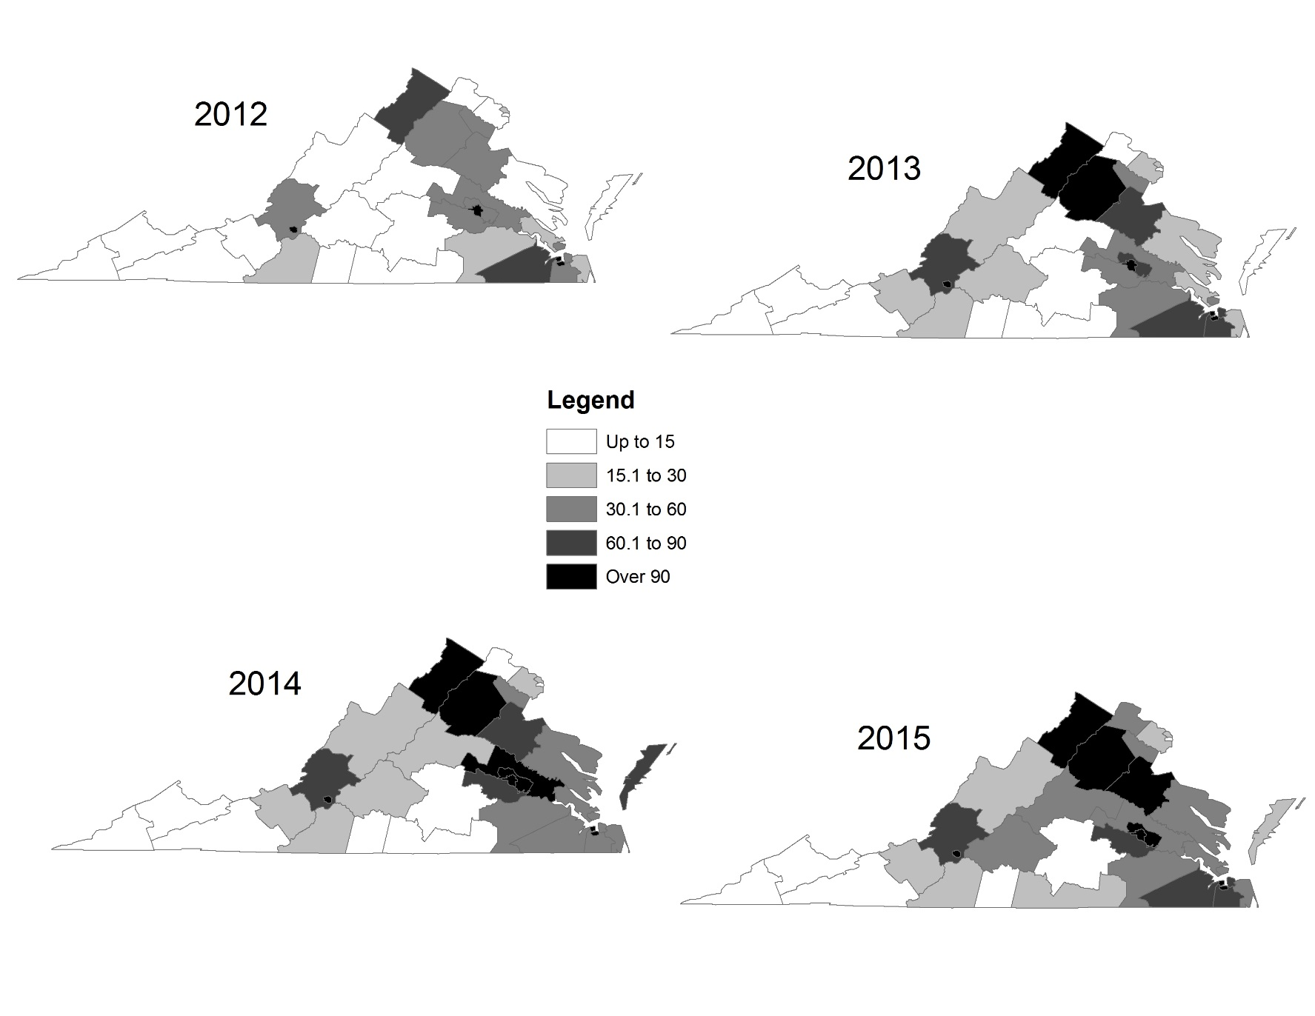
DFS Heroin Cases, By Health District Cases submitted to DFS, Rate per 100,000, By Health District 2015 Data Are Preliminary and Expected to Rise
2012
2013
Statewide: 33.0
Statewide: 47.1
2014
2015
Statewide: 54.0
Statewide: 61.3
Data Source: DFS monthly submission to NFLIS.
*2015 data are incomplete.

Slide 16
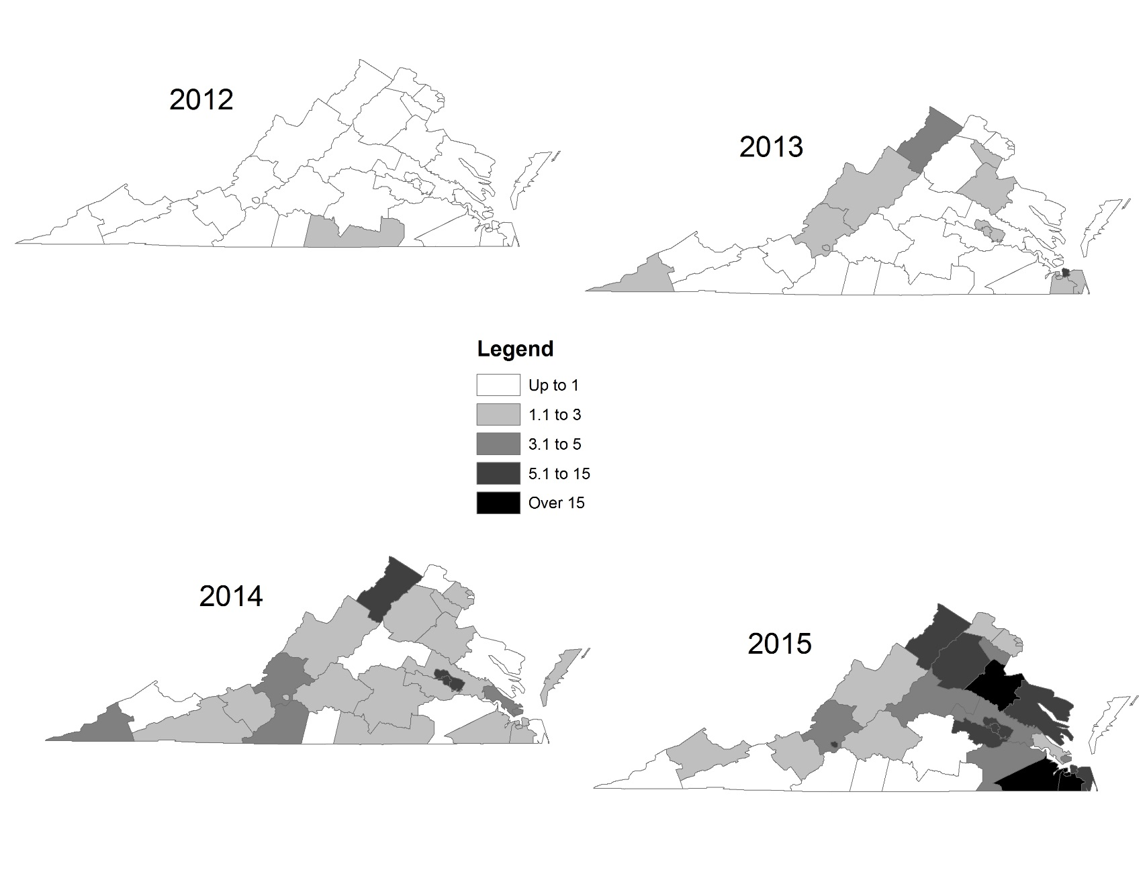
DFS Fentanyl & Derivatives Cases, By Health District Cases submitted to DFS, Rate per 100,000, By Health District 2015 Data Are Preliminary and Expected to Rise
2012
2013
Statewide: 0.1
Statewide: 1.0
2014
2015
Statewide: 2.3
Statewide: 5.8
Data Source: DFS monthly submission to NFLIS.
*2015 data are incomplete.

Slide 17
Cases Submitted to DFS Heroin vs Prescription Opioids (Left Axis) vs Fentanyl & Derivatives (Right Axis) 2015 data are incomplete.
Data Source: OCME Fata Drug Overdose Quarterly Report http://www.vdh.virginia.gov/medExam/ForensicEpidemiology.htm; DFS monthly submission to NFLIS.
*2015 data are incomplete.
Notes:
Statewide, methamphetamine cases submitted to DFS increased 264% between CY 2001 and 2005. Following a high number of methamphetamine lab seizures, the number of methamphetamine cases dropped for several years, dropping 44% between 2005 and 2008. Between 2008 and 2014, cases increased 124%.The largest growth has been in Divisions 4 and 6.

Slide 18
Fatalities: Fentanyl and/or Heroin 2015 data are incomplete. Presented here are predicted totals, subject to change.
2013-14 | 17% | 5% | 267% | 3%
2014-15* | 10% | 10% | 332% | -18%
Data Source: OCME Fata Drug Overdose Quarterly Report http://www.vdh.virginia.gov/medExam/ForensicEpidemiology.htm
*2015 data are incomplete.

Slide 19
Conclusions
Unlike cases prior to 2013, the majority of fentanyl overdoses are the result of illicitly produced fentanyl, rather than prescription fentanyl.
When fentanyl cases are excluded, preliminary 2015 data indicate a drop in fatal overdoses due to prescription opioids.
Fatal overdoses due to heroin and fentanyl have risen sharply, exceeding fatalities due to prescription opioids.
Although there are signs that actions taken to reduce prescription opioid overdoses are having an impact, there is no reason to believe that those actions would have a similar impact on illicitly produced fentanyl or heroin.

Slide 20
Acknowledgments
Special thanks to:
Rosie Hobron, OCME
John Przybylski, DFS
Anne Zehner, OFHS

